Slide 1


SprintKeel®
PRODUCT OVERVIEW · 2026
The board people open.
The plan leads trust.
Project management between Trello and Jira: a visual board, real sprints, a Gantt roadmap, and delivery reports. Company licence or self-host — not a seat tax that grows with every hire.
Developed and backed by an IIITB Alumnus
Ruby Seven Studios
Ember Casino
Woxsen University
sprintkeel.chotalabs.com · hello@chotalabs.com · Chotalabs

Slide 2
WHAT IT IS
Trello muscle. Jira planning. Hours on the card.
Columns and drag-and-drop people already know — plus issue keys, backlog vs sprint, a roadmap, velocity, and workload.
Board
Backlog & sprints
Roadmap & reports
Custom columns, cards, points, people, an active sprint. The visual ease of Trello, with sprint context Jira users expect.
Start and complete sprints. Issue keys. Points and hours. CSV import and Excel export. Closed sprints stay in the plan.
Gantt by epic, person, or sprint. Velocity, throughput, and load vs capacity in points or hours.
Mentions · workspaces · Excel export · checklists · CSV import
SprintKeel® · sprintkeel.chotalabs.com · hello@chotalabs.com
2 / 12

Slide 3
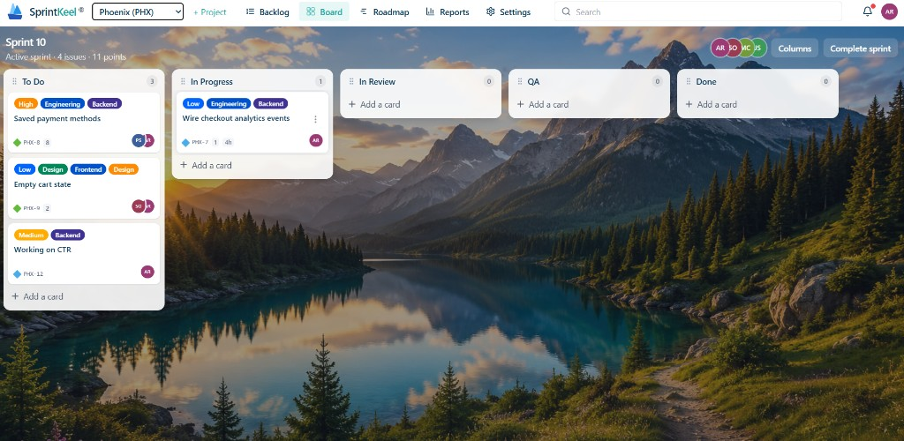
PRODUCT · BOARD
The board people open every morning
Columns, cards, points, people, an active sprint. Drag work. Custom columns.
SprintKeel® · sprintkeel.chotalabs.com · hello@chotalabs.com
3 / 12

Slide 4
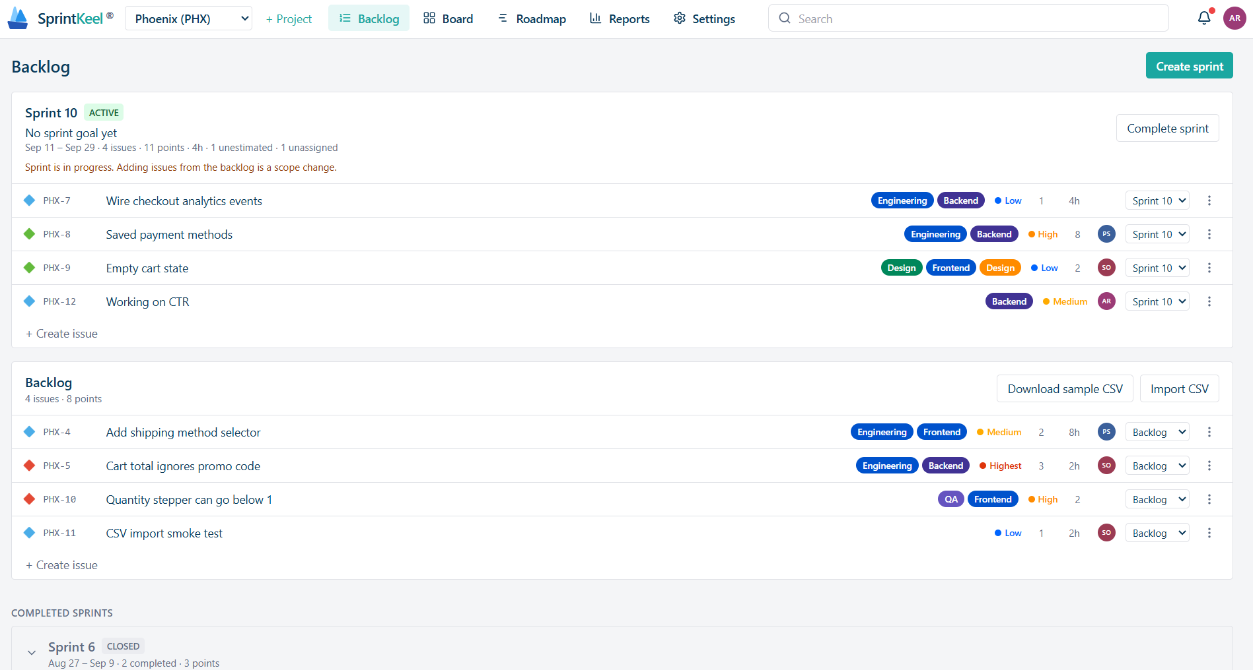
PRODUCT · BACKLOG & SPRINTS
Project planning and sprint planning in one list
Active sprint vs backlog. Keys like PHX-7. Import CSV, export Excel, complete a sprint without losing history.
SprintKeel® · sprintkeel.chotalabs.com · hello@chotalabs.com
4 / 12

Slide 5
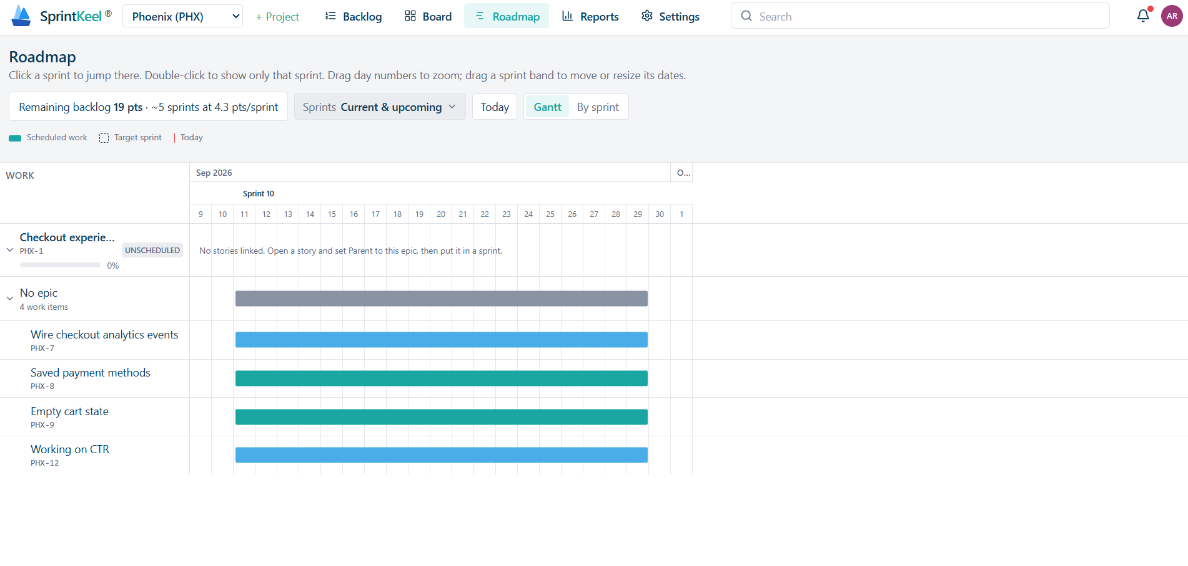
PRODUCT · ROADMAP
When will this land?
Remaining points translated into sprints at your velocity. Drag dates. Group by epic, person, or sprint.
SprintKeel® · sprintkeel.chotalabs.com · hello@chotalabs.com
5 / 12

Slide 6
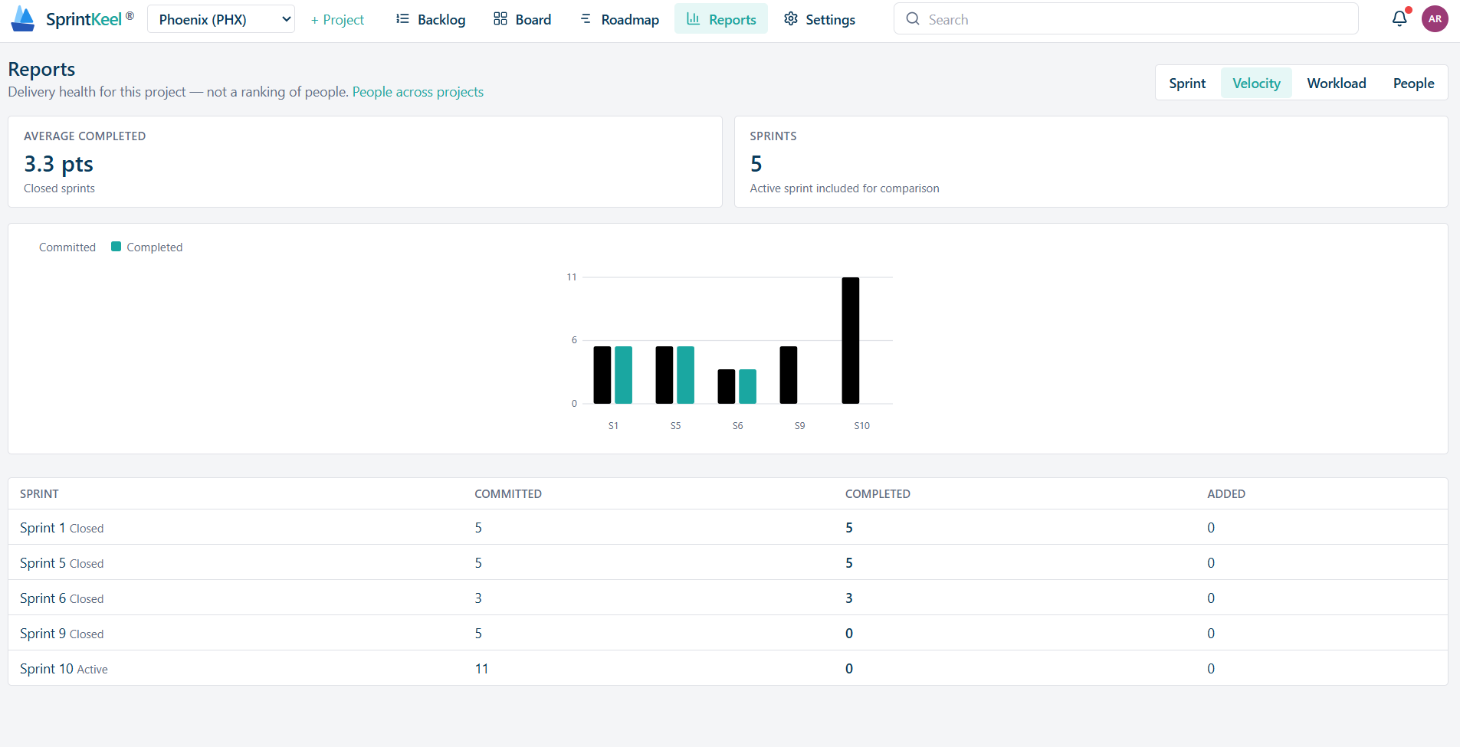
PRODUCT · REPORTS
Did we finish what we promised?
Committed vs completed by sprint. Average completed points — the number used to say yes or no to more scope.
SprintKeel® · sprintkeel.chotalabs.com · hello@chotalabs.com
6 / 12

Slide 7
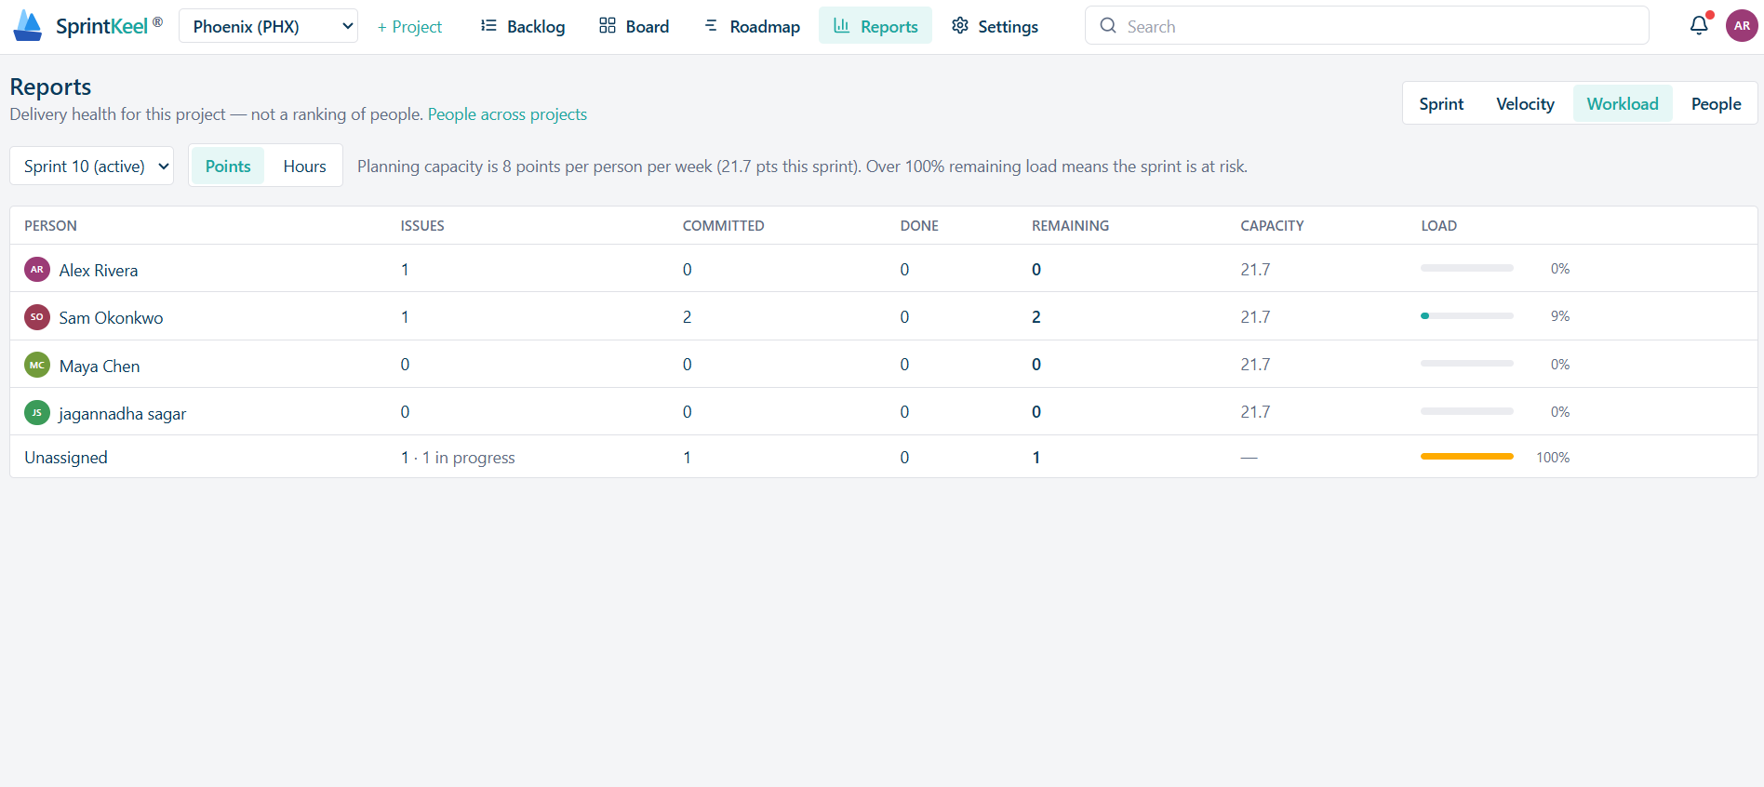
PRODUCT · WORKLOAD
Is the sprint at risk?
Load vs capacity per person, in points or hours. Estimates and spent time sit on the issue — not a separate timesheet portal.
SprintKeel® · sprintkeel.chotalabs.com · hello@chotalabs.com
7 / 12

Slide 8
WHY TEAMS SWITCH
One board. Not three tools and a licence per person.
List prices below are typical published cloud seats. SprintKeel is a company licence or self-host — not a meter on every new joiner.
 | Trello Standard | Jira Cloud | SprintKeel
What it is | A board | Full Atlassian PM | Board + backlog + sprints + roadmap + reports
How you pay | ~USD 5–6 / user / month | ~USD 8–14 / user / month | One Enterprise licence, or self-host
70 people / year | ~USD 4,200 | ~USD 7,000–11,760 | Enterprise USD 9,900 — or self-host + your cloud (~USD 850 in India)
Data | Atlassian cloud | Atlassian cloud | Our cloud, your region, or your own servers
SprintKeel® · sprintkeel.chotalabs.com · hello@chotalabs.com
8 / 12

Slide 9
LICENCES · 2026 LIST
Pick how you run it
Software licence is what you pay us. Cloud machines are extra only on self-host — or included on Enterprise hosted.
ENTERPRISE
Enterprise
Self-host
$9,900
$2,990
per year · unlimited users, one org
per year · one production install
One company licence. Dedicated instance, named support, your SMTP.
You run Node + Postgres. You own the data. You pay the cloud provider.
• Unlimited seats — hire without a new invoice
• Dedicated host, or deploy into your VPC
• Priority support · 99.5% uptime target
• Extra org: $2,400 / year each
• Software licence only — infra is yours
• Same product, your backups and region
• Updates for the licensed year
• Optional onboarding: $1,500 one-time
SprintKeel® · sprintkeel.chotalabs.com · hello@chotalabs.com
9 / 12

Slide 10
LICENCES · INR
Same plans, India invoices
List prices for 2026. India invoices add GST. USD billed annually unless we agree otherwise.
Plan | USD | INR | What you get
Enterprise | $9,900 / year | ₹8,49,000 / year | Unlimited seats, one org, dedicated instance.
Self-host | $2,990 / year | ₹2,49,000 / year | Software only. You pay the cloud.
Extra org | $2,400 / year | ₹1,99,000 / year | Additional organisation on Enterprise.
Onboarding | $1,500 once | ₹1,25,000 once | Optional for self-host.
SprintKeel® · sprintkeel.chotalabs.com · hello@chotalabs.com
10 / 12

Slide 11
SELF-HOST · WHAT YOU PAY THE CLOUD, NOT US
Typical infra for 70–200 people
SprintKeel is a small Node app. Headcount barely moves the box size. These are planning estimates; you pay the provider invoice.
Setup | What you run | Approx. yearly
India, lean | 1 VPS (2 vCPU / 4 GB): Node + Postgres + HTTPS | ₹24,000–42,000
India, comfortable | App + managed Postgres + files + Cloudflare + backups | ₹42,000–72,000 · ~$850
Two regions | Split offices. API + Postgres replica in the second region | $960–2,160
Worldwide (3 regions) | Americas + Europe + Asia. Plan on ~$200 / month | $1,800–3,360
Year-one in India ≈ licence ₹2,49,000 + cloud ~₹72,000 + optional onboarding ₹1,25,000. Still under a year of Jira Cloud for 70 people at USD 14 / user / month (~USD 11,760).
SprintKeel® · sprintkeel.chotalabs.com · hello@chotalabs.com
11 / 12

Slide 12

NEXT STEP
Tell us Enterprise
or self-host.
Email hello@chotalabs.com with headcount, region, and whether you want us to host or you will. We reply with a one-page quote.
hello@chotalabs.com
SprintKeel® — the board people open. The plan leads trust. © 2026 Chotalabs

